Slide 1
Movie Rating Visual Analysis
Advanced Visualizations using ggplot() in Rstudio
Key concepts:
Downloading ggplot2 package
Reading csv file in R
Quick understanding and data checks: head(), tail() and summary()
Converting non-factor variables into factors (data with levels)
Using ggplot2 to generate line chart, box plots, scatter plots, histograms and density charts
Improving visualization by
Mapping and setting
Adding colors
Adding borders
Setting bin width in histogram
increasing/decreasing transparency using alpha()
How can we make code flexible by overriding mapping variables
Statistical transformations
Using facet grids and scales
Theme functions
Dataset: movie rating.csv (https://www.superdatascience.com/pages/rcourse)

Slide 2
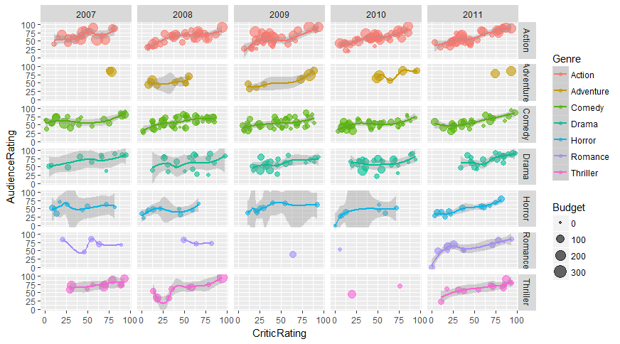
Visualizing genre trends over years
This view gives a typical trending view of how movies of different genres are performing over the years
We can find that comedy movies over years have similar audience rating typically above 50%
Over the years, the drama category has improved and it seems audience is preferring it
The size of dots represents the budget so we can find a lot of high budget movies in action category and rating behavior is fairly linear i.e. audience rates rating almost similar to critics or slightly better

Slide 3
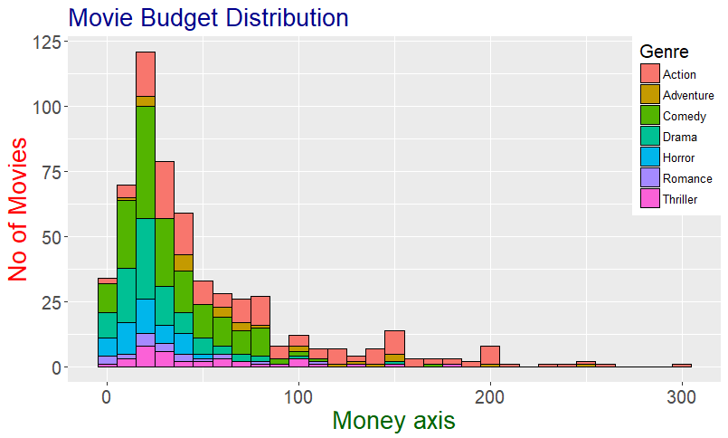
Histogram
We are showing the histogram distribution of movie budget across different genres
You can draw insights of the genre of few of high budget movies
e.g. the genre of movies above $200 Million is typically ‘Action’
We can clearly identify that large chunk of movies made are within $100 million budget and very few beyond it

Slide 4
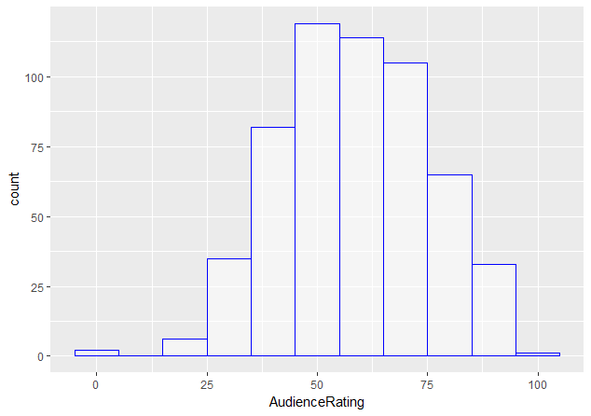
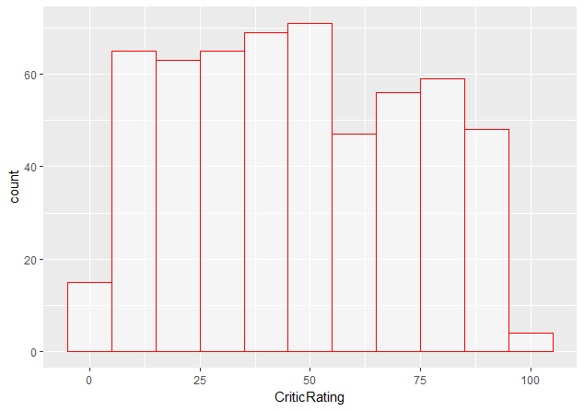
Histogram – cont’d
We are showing 2 histograms just to identify and share how audience and critic rate movies
The audience histogram tells us behavior of audience in rating a movie is fairly predictable or biased since most points lie in between 40 to 70
The critical histogram is bit uniform since they rate movies in depth based on different factors and hence we can find a uniform distribution of ratings

Slide 5
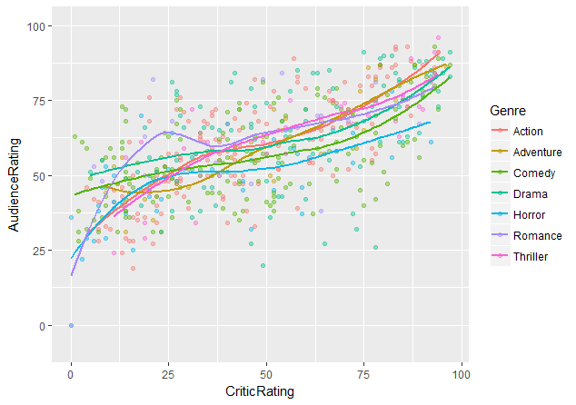
Scatter plot with trend lines
We have created a typical scatter plot with trend lines to predict the nature of ratings for every genre
For romantic movies, we can see that critics typically rating a movie between 25 gets a different response from audience in form of rating spike 50-60
We can observe that action movie above 50% rating is responded very well by audience with corresponding rating of min 60% or more

Slide 6
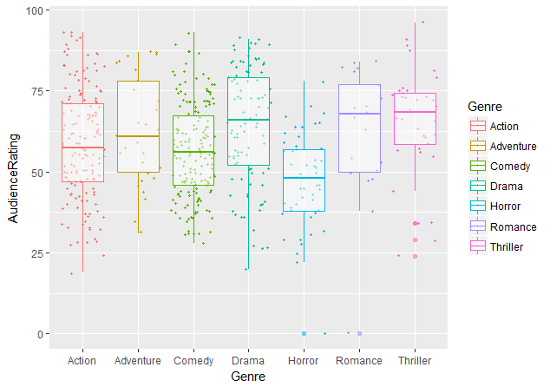
Box Plot
Box plot to display distribution of audience rating for each genre
You can guess basically the rating of the movie based on genre and study the variance
Say for Adventure genre, mean depicted by solid line inside the box lies around 60 however it has huge variance. So if you’re planning to make adventure movie it could be bit risky since audience can rate it anywhere between 48 to 77
The safe bet could be in making a Thriller movie since audience typically has small variance from 60 to 75 and mean is typically observed at 70

